Slide 1
Announcements
I’ll be teaching two courses next semester
CIS 530 – Computational Linguistics
http://computational-linguistics-class.org
NETS 213 – Crowdsourcing and Human Computation
http://crowdsourcing-class.org
If you’re interested in enrolling in either one, you can request permission via the waitlist: https://forms.cis.upenn.edu/waitlist/
I’ll pick 50 students for each sometime later this semester.
Currently 130+ students are on the waitlist for CIS 530, and 70+ are on the waitlist for NETS 213.

Slide 2
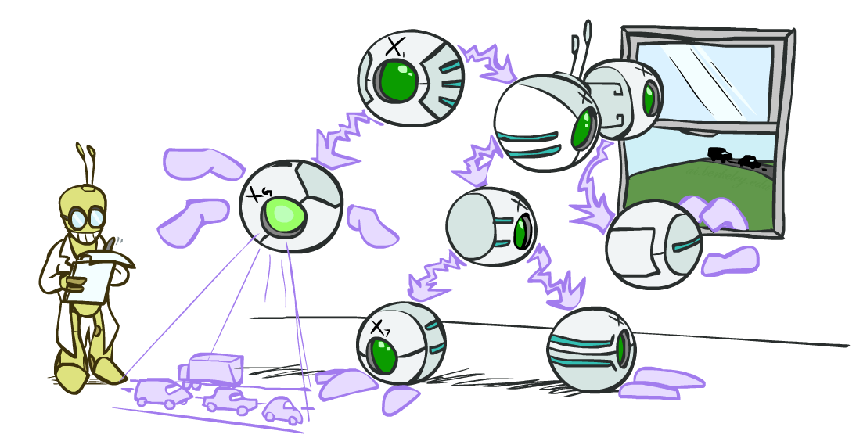
Bayes’ Nets part 3
Slides courtesy of Dan Klein and Pieter Abbeel --- University of California, Berkeley
[These slides were created by Dan Klein and Pieter Abbeel for CS188 Intro to AI at UC Berkeley. All CS188 materials are available at http://ai.berkeley.edu.]
Notes:
Please retain proper attribution, including the reference to ai.berkeley.edu. Thanks!

Slide 3
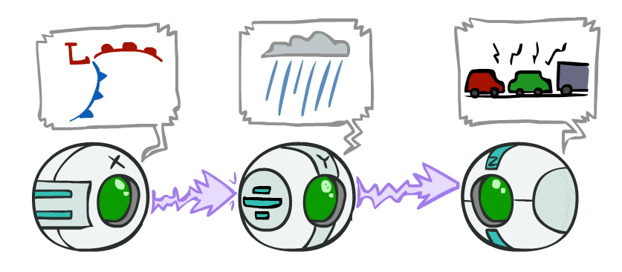
Recap: Causal Chains
This configuration is a “causal chain”
Guaranteed X independent of Z ? No!
One example set of CPTs for which X is not independent of Z is sufficient to show this independence is not guaranteed.
Example:
Low pressure causes rain causes traffic,
high pressure causes no rain causes no
traffic
In numbers:
P( +y | +x ) = 1, P( -y | - x ) = 1,
P( +z | +y ) = 1, P( -z | -y ) = 1
X: Low pressure Y: Rain Z: Traffic
Notes:
The numbers show a deterministic chain. It renders X and Z not independent. X is always == Z.

Slide 4
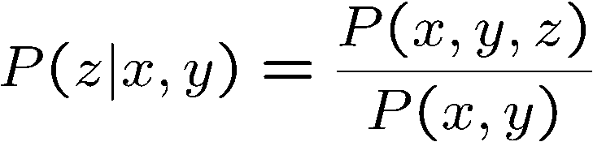
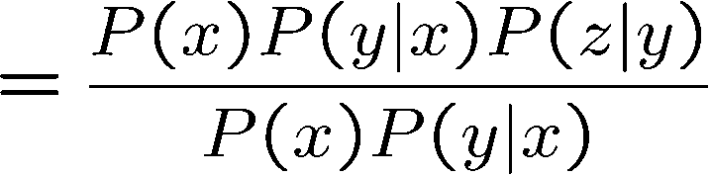
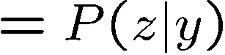
Recap: Causal Chains
This configuration is a “causal chain”
Guaranteed X independent of Z given Y?
Evidence along the chain “blocks” the influence
X: Low pressure Y: Rain Z: Traffic
Yes!
Notes:
Show what cancels out.
The assumptions that are available to us are given by P(X,Y,X) = P(X) P(Y|X) P(Z|Y)

Slide 5
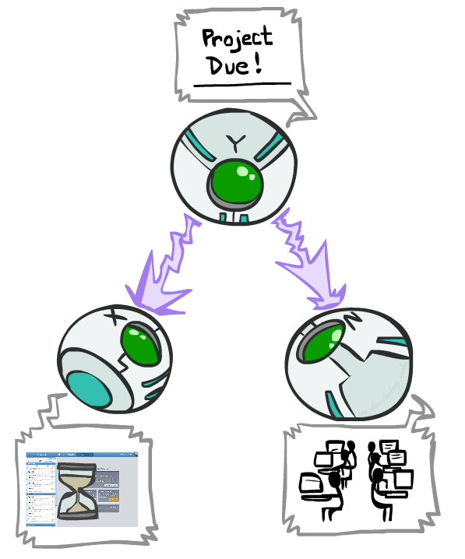
Recap: Common Cause
This configuration is a “common cause”
Guaranteed X independent of Z ? No!
One example set of CPTs for which X is not independent of Z is sufficient to show this independence is not guaranteed.
Example:
Project due causes both forums busy
and office hours to be full
In numbers:
P( +x | +y ) = 1, P( -x | -y ) = 1,
P( +z | +y ) = 1, P( -z | -y ) = 1
Y: Project due
X: Forums busy
Z: Office hours full
Notes:
If X is always equal to Y and Z is always equal to Y, then they’re not independent.

Slide 6
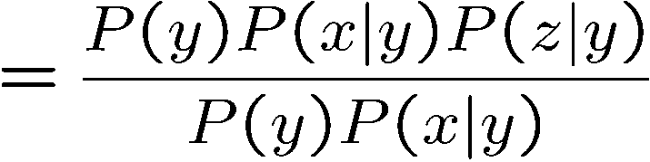
Recap: Common Cause
This configuration is a “common cause”
Guaranteed X and Z independent given Y?
Observing the cause blocks influence between effects.
Y: Project due
X: Forums busy
Z: Office hours full
Yes!

Slide 7
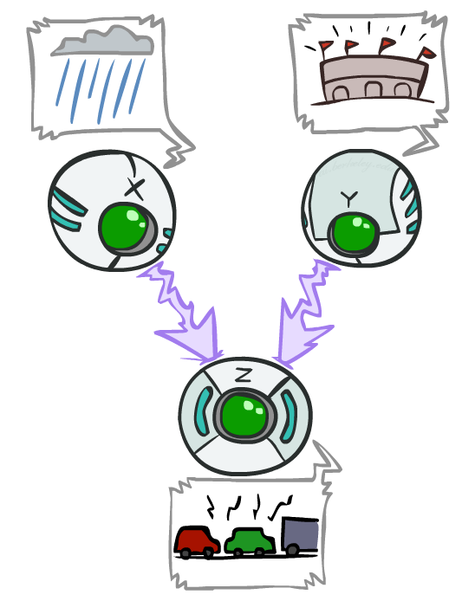
Recap: Common Effect
Last configuration: two causes of one effect (v-structures)
Are X and Y independent?
Yes: the ballgame and the rain cause traffic, but they are not correlated
Still need to prove they must be (try it!)
Are X and Y independent given Z?
No: seeing traffic puts the rain and the ballgame in competition as explanation.
This is backwards from the other cases
Observing an effect activates influence between possible causes.
X: Raining
Y: Ballgame
Z: Traffic
Notes:
Special case where observing the thing in the middle make things depend on each other. You have two causes. One of the causes must be true. Observing one of the causes to be true, means that the second cause doesn’t have to be true. Seeing one explains away the need for the other.
From the Bayes net we know that:
P(C,B,E) = P(C) P(B) P(E | B, C)
we can sum over E on both sides:
Σ_ E P(C,B,E) = Σ_E P(C) P(B) P(E | B, C)
we can rearrange the righthand side to move the sub to what it scopes over:
Σ_E P(C,B,E) = P(C) P(B) Σ_E P(E | B, C)
the term Σ_E P(E | B, C) = 1, so we are left with:
P(C,B) = P(C) P(B)
which is the definition of independence.
Alternately we can use the independence assumptions that are encoded in all Bayes Nets.
X_i _||_ X_1 … X_i-1 – parents(X_i) | parents (X_i).
An ordering we could take here is X, Y, Z, so
X _||_ Y | empty set.

Slide 8
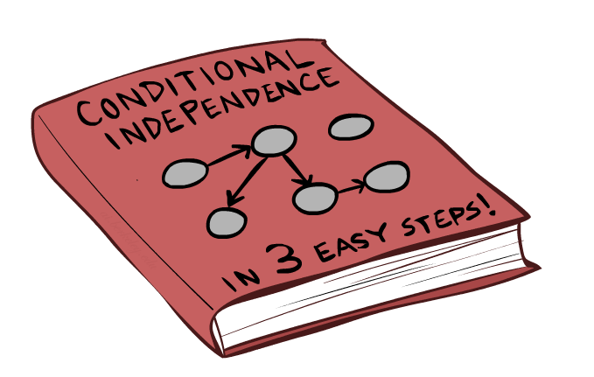
The General Case for Independence

Slide 9
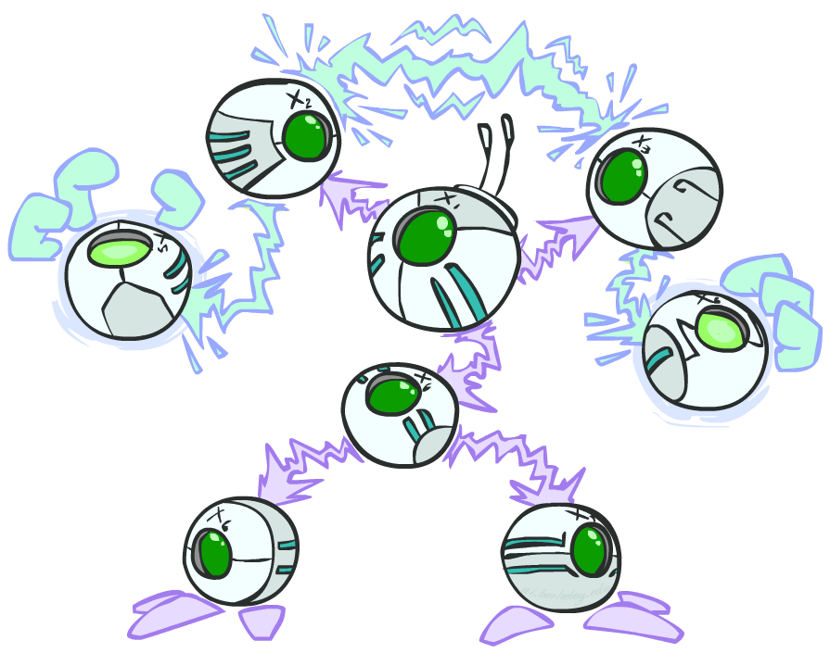
The General Case
General question: in a given BN, are two variables independent (given some evidence)?
Solution: analyze the graph
Any complex example can be broken
into repetitions of the three canonical cases
Notes:
Break the graph down to triples. Check if there is influence running along those triples. Analyze the graph. check everywhere in the graph where influence can run between two variables, or see if it is blocked.

Slide 10

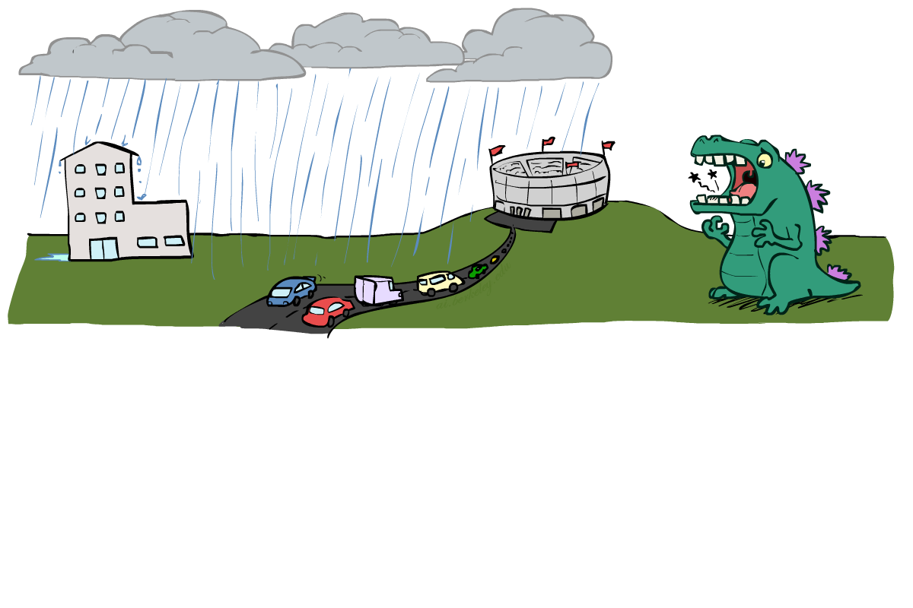
Reachability
L
Recipe: shade evidence nodes, look for paths in the resulting graph
Attempt 1: if two nodes are connected by an undirected path not blocked by a shaded node, they are conditionally independent
Almost works, but not quite
Where does it break?
Answer: the v-structure at T doesn’t count as a link in a path unless “active”
R
B
D
T
Notes:
First attempt: check whether there’s a path between two variables. Check whether it’s been blocked by some evidence. If not, then they are conditionally independent.
Too simple.
Observing T lets the influence run between R and B.

Slide 11
Active / Inactive Paths
Question: Are X and Y conditionally independent given evidence variables {Z}?
Yes, if X and Y “d-separated” by Z
Consider all (undirected) paths from X to Y
No active paths = independence!
A path is active if each triple is active:
Causal chain A → B → C where B is unobserved (either direction)
Common cause A ← B → C where B is unobserved
Common effect (aka v-structure)
A → B ← C where B or one of its descendants is observed
All it takes to block a path is a single inactive segment
Active Triples
Inactive Triples
Notes:
First one is a causal change. When the middle variable isn’t active, then there’s influence between the first and the third. However, once you observe the middle variable, it blocks the influences between them and makes them independent.
Second is the common cause. Same story.
Third is the common effect. This is the odd one out.
What does it mean to be an active triple or inactive triple in the larger context?
If every triple along a path is active, then we have an active path.
If one or more triples is in active, then the whole path is inactive.

Slide 12
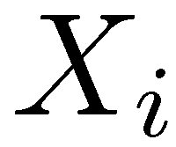
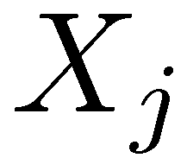
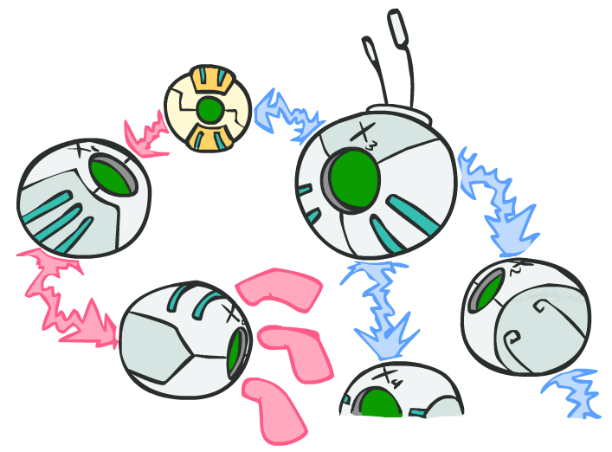
D-Separation
?
Query:
Check all (undirected!) paths between and
If one or more active, then independence not guaranteed
Otherwise (i.e. if all paths are inactive),
then independence is guaranteed
Notes:
Is it guaranteed to be true for Xi and Xj are independent given these variables and given this BN structure.
Just not guaranteed. It could be there or not. (If every distribution becomes a uniform distribution given the parent variables, then no dependencies)

Slide 13
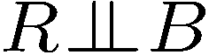
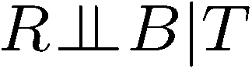
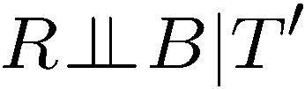
Example
Yes
R
B
T
T’
Notes:
T’: traffic report
Given T == T is observed. NO, not guaranteed to be true.
Given T’ == T’ is observed. NO, not guaranteed to be true.
R_||_B Yes – it’s got one path. It’s a common effect. It’s an inactive triple because the effect isn’t observed, and none of its children are observed. Therefore it’s an inactive triple and an inactive path, so independence is guaranteed.
R_||_B|T No –It’s a common effect. But now the effect is observed, so it’s an active triple. All of the triples along the path (there’s only one in this case), so the path is active. so independence is NOT guaranteed.
R_||_B|T’ How about when we condition on T1 instead of T? No –It’s still an active triple since one of the decedents of the effect is observed. All of the triples along the path (there’s only one in this case), so the path is active. so independence is NOT guaranteed.

Slide 14
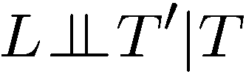
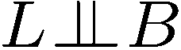
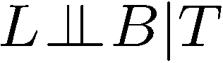
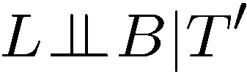
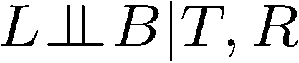
Example
L
Yes
R
B
Yes
D
T
Yes
T’
Notes:
L_||_T’|T – yes! Just one path. We need to check all triples. If one of the triples is inactive, then the whole path is inactive. So There’s two triples, one is inactive, so the whole path is inactive, so independence is guaranteed.
L_||_B – Yes! Two triples. B-T-R is an inactive triple, since it’s a common effect. So that makes the whole path inactive. There’s only one path, so independence is guaranteed.
L_||_B|T – No! The common effect is now active. So the path is active. First triple L-R-T, the third element is observed. That doesn’t actually matter. We only care about the middle node in the triples. 2nd one R-T-B the middle one is observed. Common effect is active.
L_||_B|T’ – No! Same as before. The descendent of a common effect is observed, so it’s active.
L_||_B|T,R – yes! How about with more observations. The L-R-T is a causal chain. The middle is observed, so its inactive. That makes the path inactive, and we don’t need to check the second triple, so independence is guaranteed.
When you look at triples, all that matters is whether the middle one is active, not the side ones.
1,2 and 5 are true.

Slide 15
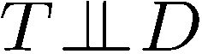
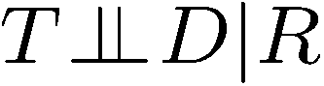
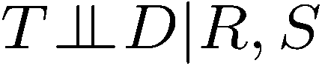
Example
Variables:
R: Raining
T: Traffic
D: Roof drips
S: I’m sad
Questions:
R
T
D
S
Yes
Notes:
T_||_D – no! We just need to find a path that is inactive. T-R-D is a common cause. That’s active, so we have an active path. For T-S-D, that’s a common effect, so it’s not active. But we have at least one active path, so we don’t have the guarantee.
T_||_D|R -- Yes! now R is observed. Middle is observed in the common cause, so it makes it inactive. The common effect path is also inactive, so all paths are inactive. That guarantees the independence to be true.
T_||_D|R,S No! now R and S are both observed. Middle is observed in the common cause, so it makes it inactive. The common effect path is now active, so there is one active path. That means that we don’t have the independence guarantee anymore. We have one active path, independence is not guarantee to be true.

Slide 16

Structure Implications
Given a Bayes net structure, can run d-separation algorithm to build a complete list of conditional independences that are necessarily true of the form
This list determines the set of probability distributions that can be represented

Slide 17

Computing All Independences
Y
X
Z
Y
X
Z
X
Z
Y
Y
X
Z
Notes:
All Independences that are guaranteed to be true:
X_||_Z|Y
X_||_Z|Y
X_||_Z
None. With 4, you can represent any distributions. No assumptions about what is independent.

Slide 18
Topology Limits Distributions
Given some graph topology G, only certain joint distributions can be encoded
The graph structure guarantees certain (conditional) independences
(There might be more independence)
Adding arcs increases the set of distributions, but has several costs
Full conditioning can encode any distribution
Y
Y
X
Z
X
Z
Y
X
Z
Y
X
Z
Y
Y
Y
X
Z
X
Z
X
Z
Y
Y
Y
X
Z
X
Z
X
Z

Slide 19
Bayes Nets Representation Summary
Bayes nets compactly encode joint distributions
Guaranteed independencies of distributions can be deduced from BN graph structure
D-separation gives precise conditional independence guarantees from graph alone
A Bayes’ net’s joint distribution may have further (conditional) independence that is not detectable until you inspect its specific distribution

Slide 20

Video of Demo BN Applet

Slide 21

Inference
Inference: calculating some useful quantity from a joint probability distribution
Examples:
Posterior probability
Most likely explanation:
Notes:
Answer some useful query about a probability distribution.
Two use cases.
1. Determine the posterior probability of some query given some evidence.
2. Pick the most likely instantiation of the query variable given that evidence.
We’ll focus on the first one, but the second can be answered in a very similar way. You’ll change summations with maxes.

Slide 22
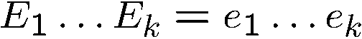
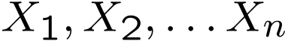
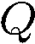
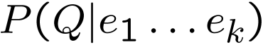
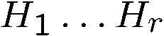
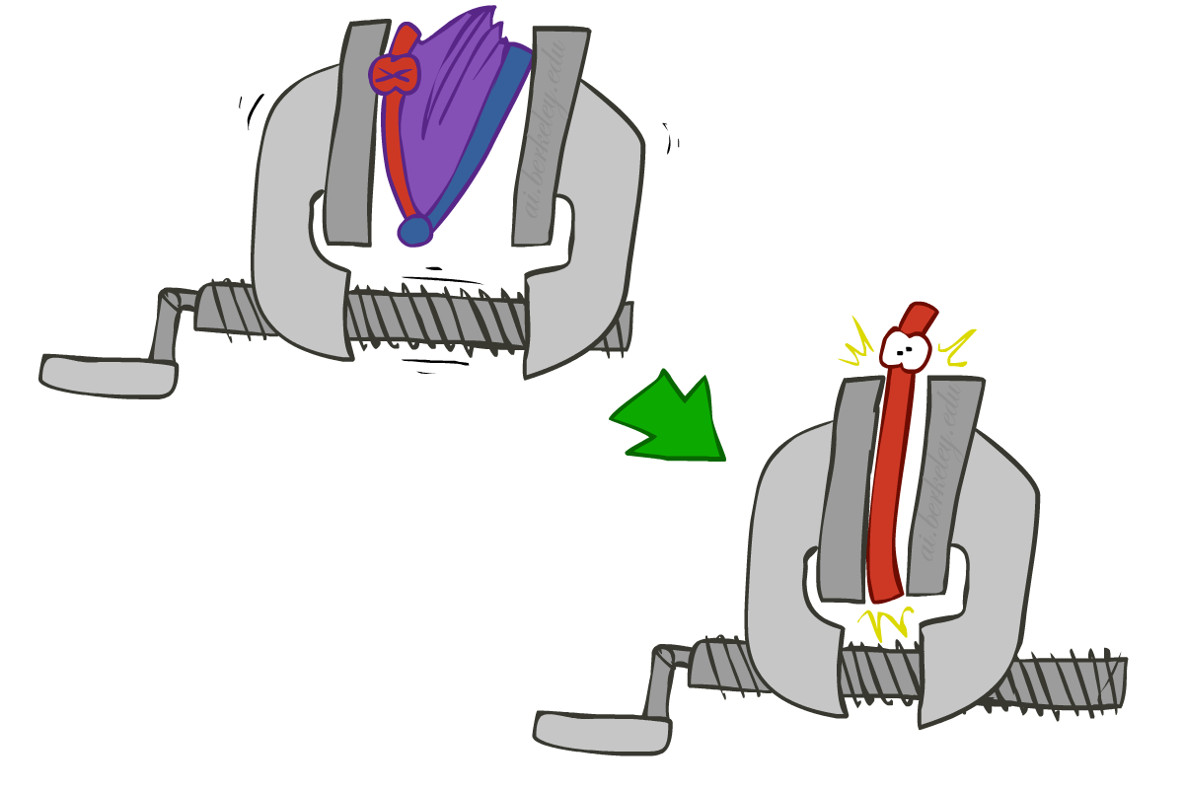
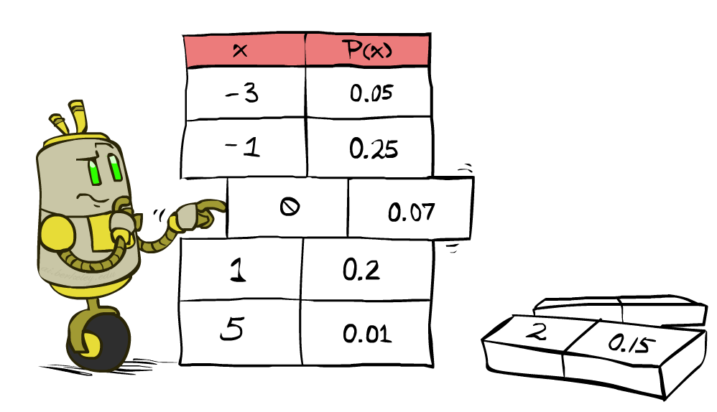
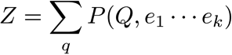
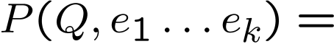
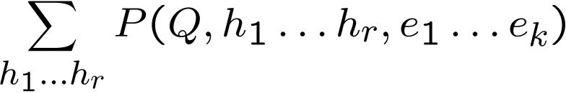
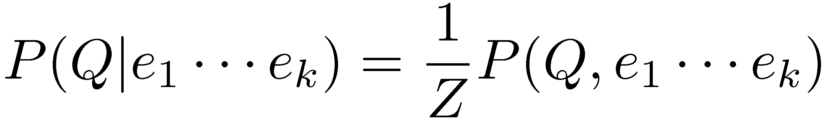
Inference by Enumeration
* Works fine with multiple query variables, too
General case:
Evidence variables:
Query* variable:
Hidden variables:
We want:
All variables
Step 1: Select the entries consistent with the evidence
Step 2: Sum out H to get joint of Query and evidence
Step 3: Normalize
Notes:
Inference by enumeration is something that we looked at before.
Evidence, query and hidden variables.
Hidden variables will be summed out. Then you’ve got the joint between the query and the evidence variables. That’s not what we want, so we normalize over the query variable.

Slide 23
Inference by Enumeration in Bayes’ Net
Given unlimited time, inference in BNs is easy
Reminder of inference by enumeration by example:
B
E
A
J
M
Notes:
Query: Distribution for Burglary given +j and +m
Step 1: The conditional is proportional to the joint between these variables. We’ll re-scale by the sum of the entires.
Step 2: Sum over the hidden variables.
Step 3: Definition of the joint distribution given the Bayes Net.
Finally, spell out the sum.
B is capital because that’s still a variable. We’re building a table for it.
What’s wrong with this? We have a nice compact rep with the BN. But we then build this full joint in the sum. This gets very expensive. It’s exponential in the number of non-evidence variables.

Slide 24
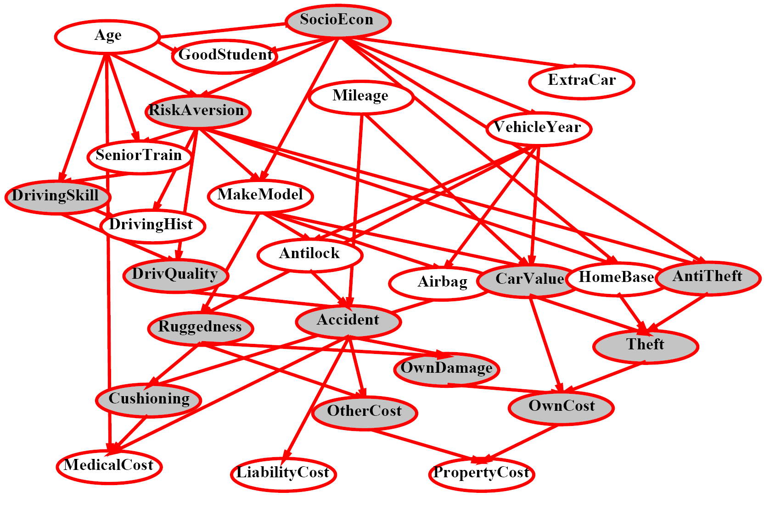
Inference by Enumeration?
Notes:
Shaded = observed.
Non-shaded= unobserved. 13 of those, so 2^13 items to compute. Too big for a simple query like this.

Slide 25
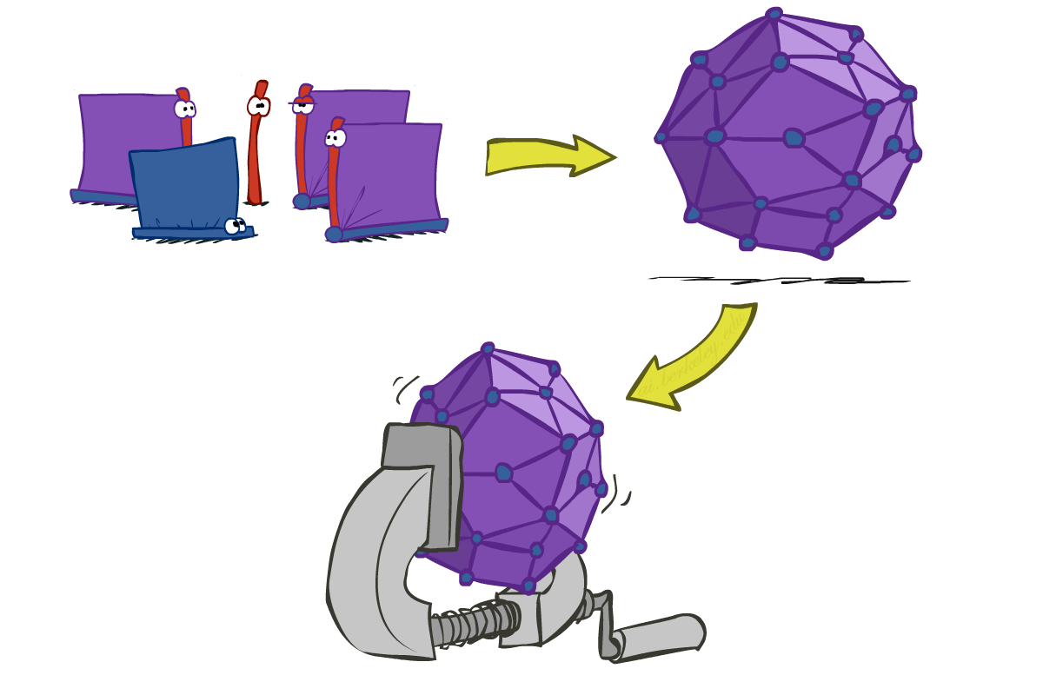
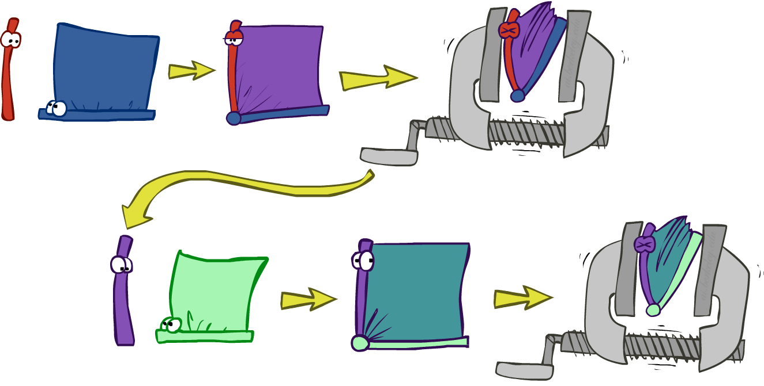
Inference by Enumeration vs. Variable Elimination
Why is inference by enumeration so slow?
You join up the whole joint distribution before you sum out the hidden variables
Idea: interleave joining and marginalizing!
Called “Variable Elimination”
Still NP-hard, but usually much faster than inference by enumeration
First we’ll need some new notation: factors

Slide 26
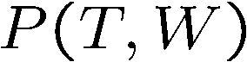

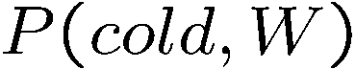
Factor Zoo I
Joint distribution: P(X,Y)
Entries P(x,y) for all x, y
Sums to 1
Selected joint: P(x,Y)
A slice of the joint distribution
Entries P(x,y) for fixed x, all y
Sums to P(x)
Number of capitals = dimensionality of the table
T | W | P
hot | sun | 0.4
hot | rain | 0.1
cold | sun | 0.2
cold | rain | 0.3
T | W | P
cold | sun | 0.2
cold | rain | 0.3
Notes:
1. P(T,W) is a factor that happens to be a joint distribution.
2. Here’s another factor. It’s called a selected joint. It doesn’t sum to 1. Factors don’t have to sum to 1.
3. The number of capitals is the size of the table. We’ll try to keep them small.

Slide 27
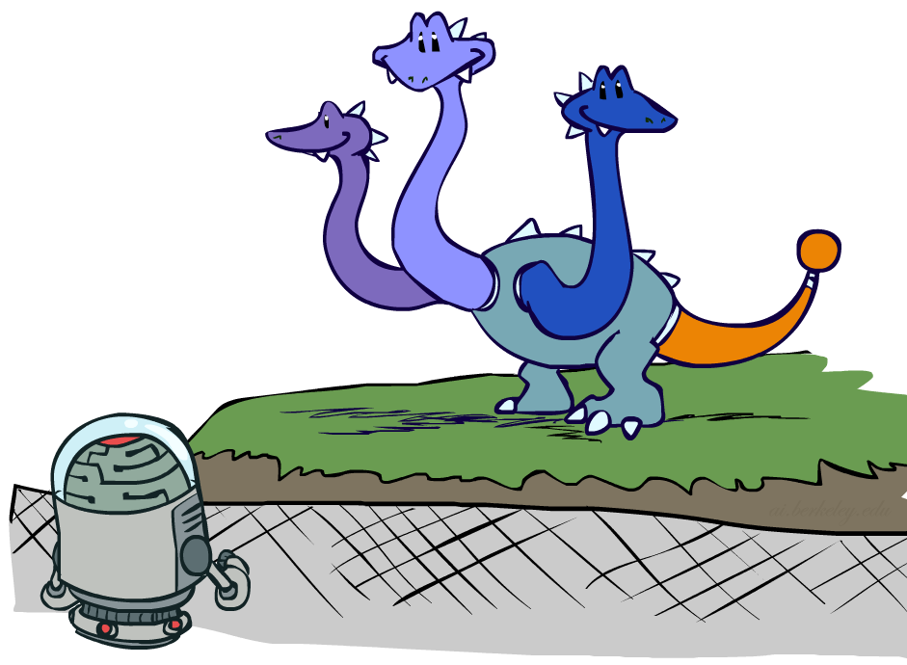
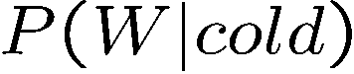
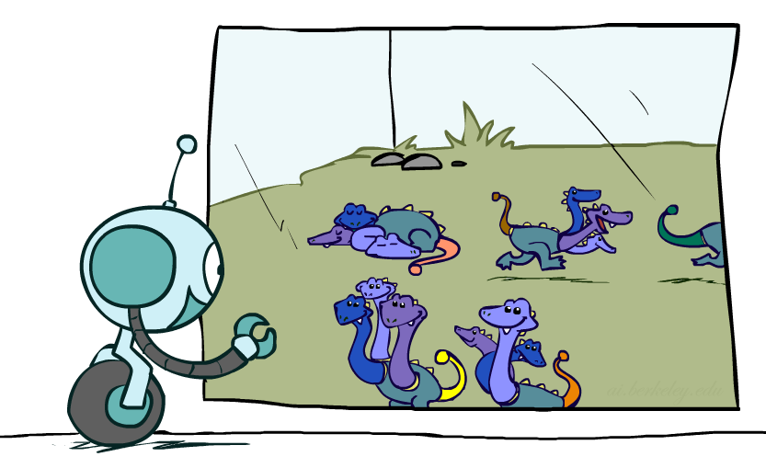
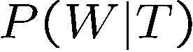
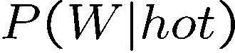

Factor Zoo II
Single conditional: P(Y | x)
Entries P(y | x) for fixed x, all y
Sums to 1
Family of conditionals:
P(X |Y)
Multiple conditionals
Entries P(x | y) for all x, y
Sums to |Y|
T | W | P
cold | sun | 0.4
cold | rain | 0.6
T | W | P
hot | sun | 0.8
hot | rain | 0.2
cold | sun | 0.4
cold | rain | 0.6
Notes:
Here are more factors.
A single conditional.
You can also have a family of conditionals.
Factors are tables. Some of the variables can vary (the capitalized ones), and there are numbers in the entries of the table.

Slide 28
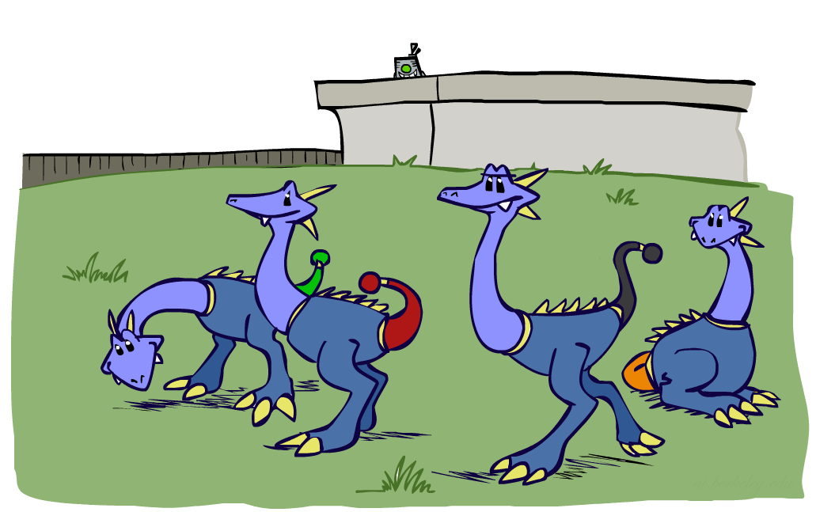
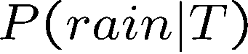
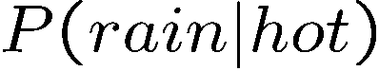
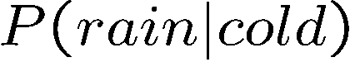
Factor Zoo III
Specified family: P( y | X )
Entries P(y | x) for fixed y,
but for all x
Sums to … who knows!
T | W | P
hot | rain | 0.2
cold | rain | 0.6
Notes:
Temperature is left unspecified. Doesn’t sum to 1. Sums to the probability of rain in this case.

Slide 29




Factor Zoo Summary
In general, when we write P(Y₁ … Y_{N} | X₁ … X_{M})
It is a “factor,” a multi-dimensional array
Its values are P(y₁ … y_{N} | x₁ … x_{M})
Any assigned (=lower-case) X or Y is a dimension missing (selected) from the array
Notes:
Big picture: There’s a lot of things that we can encounter in variable elimination. They are a mix of instantiated and uninstantiatedvariables.

Slide 30



Example: Traffic Domain
Random Variables
R: Raining
T: Traffic
L: Late for class!
+r | 0.1
-r | 0.9
R
T
+r | +t | 0.8
+r | -t | 0.2
-r | +t | 0.1
-r | -t | 0.9
L
+t | +l | 0.3
+t | -l | 0.7
-t | +l | 0.1
-t | -l | 0.9
Notes:
Here’s an example. Query is what’s the prob of being late (with no evidence).
What does inference by enumeration do? Picks out the full joint distribution since there’s no evidence. Sum over the hidden variables R and T of the full joint.
That’s inference by enumeration applied to this particular Bayes Net.

Slide 31

Variable Elimination (VE)

Slide 32







Inference by Enumeration: Procedural Outline
Track objects called factors
Initial factors are local CPTs (one per node)
Any known values are selected
E.g. if we know , the initial factors are
Procedure: Join all factors, then eliminate all hidden variables
+r | 0.1
-r | 0.9
+r | +t | 0.8
+r | -t | 0.2
-r | +t | 0.1
-r | -t | 0.9
+t | +l | 0.3
+t | -l | 0.7
-t | +l | 0.1
-t | -l | 0.9
+r | 0.1
-r | 0.9
+r | +t | 0.8
+r | -t | 0.2
-r | +t | 0.1
-r | -t | 0.9
+t | +l | 0.3
-t | +l | 0.1

Slide 33





Operation 1: Join Factors
First basic operation: joining factors
Combining factors:
Just like a database join
Get all factors over the joining variable
Build a new factor over the union of the variables involved
Example: Join on R
Computation for each entry: pointwise products
R
+r | 0.1
-r | 0.9
+r | +t | 0.8
+r | -t | 0.2
-r | +t | 0.1
-r | -t | 0.9
+r | +t | 0.08
+r | -t | 0.02
-r | +t | 0.09
-r | -t | 0.81
R,T
T
Notes:
This is just like a data base join.
Whatever was a column in any of your two factors will be a column in your new table. Then multiply together the consistent entries to get the values in the resulting table.
So –r * -r,–t will give us -r,-t in the resulting table (.9 * .9 = .81)

Slide 34

Example: Multiple Joins

Slide 35



Example: Multiple Joins
+r | 0.1
-r | 0.9
R
Join R
Join T
+r | +t | 0.08
+r | -t | 0.02
-r | +t | 0.09
-r | -t | 0.81
R, T, L
T
+r | +t | 0.8
+r | -t | 0.2
-r | +t | 0.1
-r | -t | 0.9
R, T
+r | +t | +l | 0.024
+r | +t | -l | 0.056
+r | -t | +l | 0.002
+r | -t | -l | 0.018
-r | +t | +l | 0.027
-r | +t | -l | 0.063
-r | -t | +l | 0.081
-r | -t | -l | 0.729
L
L
+t | +l | 0.3
+t | -l | 0.7
-t | +l | 0.1
-t | -l | 0.9
+t | +l | 0.3
+t | -l | 0.7
-t | +l | 0.1
-t | -l | 0.9
Notes:
Grab the two tables with R in them. That’s the join on R.
Grab all tables with T in them. That’s the join on T.
Can have more than two tables. Same procedure.

Slide 36



Operation 2: Eliminate
Second basic operation: marginalization
Take a factor and sum out a variable
Shrinks a factor to a smaller one
A projection operation
Example:
+r | +t | 0.08
+r | -t | 0.02
-r | +t | 0.09
-r | -t | 0.81
+t | 0.17
-t | 0.83
Notes:
Eliminate the hidden variables.
If we want to eliminate R, we get a smaller table, which just has the variables T.
Sum together the variables for +t in the first table (0.08 + 0.08 = 0.17).

Slide 37



Multiple Elimination
R, T, L
T, L
L
+r | +t | +l | 0.024
+r | +t | -l | 0.056
+r | -t | +l | 0.002
+r | -t | -l | 0.018
-r | +t | +l | 0.027
-r | +t | -l | 0.063
-r | -t | +l | 0.081
-r | -t | -l | 0.729
Sum
out R
Sum
out T
+t | +l | 0.051
+t | -l | 0.119
-t | +l | 0.083
-t | -l | 0.747
+l | 0.134
-l | 0.886
Notes:
You can do this for multiple variables.
Sum out over R. For the first row in P(T,L) we sum over the consistent entries in the R,T,L table (+r,+t,+l plus –r,+t+l) 0.024+0.027 = 0.051.
We can do the same thing to sum out T.

Slide 38

Thus Far: Multiple Join, Multiple Eliminate (= Inference by Enumeration)
Notes:
Inference by enumerations = Do all the joins first, then do all of the eliminations.

Slide 39

Marginalizing Early (= Variable Elimination)
Notes:
Variable elimination = interleaving them.
Join on a variable, then eliminate it. If you want to eliminate a variable, you cannot do so until you’ve joined it. Joining it captures all of the relationships that are mediated via your hidden variables. Once you’ve eliminated it you’ve got those relationships. But you must join first.

Slide 40
Traffic Domain
R
Inference by Enumeration
Variable Elimination
T
L
Join on r
Join on r
Join on t
Eliminate r
Eliminate r
Join on t
Eliminate t
Eliminate t
Notes:
Here’s two different ways of answering the query “What’s the probability of being late?”
We can move the summation over R further back, because the first term doesn’t involve R. Product is commutative.
Joining on R give us a factor over R and T.
Eliminating R gives us a factor just on T. We can denote this new factor as F_1(T). Then we’re left with F_1(T) and P(L|T).
Joining on T gives us the factor on L and F_1(T).
Eliminating T gives us the answer to our query on L.

Slide 41


Marginalizing Early! (aka VE)
Join R
Sum out R
Join T
Sum out T
+r | +t | 0.08
+r | -t | 0.02
-r | +t | 0.09
-r | -t | 0.81
+r | 0.1
-r | 0.9
+t | 0.17
-t | 0.83
R
T
T, L
R, T
L
+r | +t | 0.8
+r | -t | 0.2
-r | +t | 0.1
-r | -t | 0.9
T
L
L
+t | +l | 0.051
+t | -l | 0.119
-t | +l | 0.083
-t | -l | 0.747
+l | 0.134
-l | 0.866
L
+t | +l | 0.3
+t | -l | 0.7
-t | +l | 0.1
-t | -l | 0.9
+t | +l | 0.3
+t | -l | 0.7
-t | +l | 0.1
-t | -l | 0.9
+t | +l | 0.3
+t | -l | 0.7
-t | +l | 0.1
-t | -l | 0.9
Notes:
After summing out over R, P(T) could just be called F_1(T).

Slide 42




Evidence
If evidence, start with factors that select that evidence
No evidence uses these initial factors:
Computing , the initial factors become:
We eliminate all vars other than query + evidence
+r | 0.1
-r | 0.9
+r | +t | 0.8
+r | -t | 0.2
-r | +t | 0.1
-r | -t | 0.9
+t | +l | 0.3
+t | -l | 0.7
-t | +l | 0.1
-t | -l | 0.9
+r | 0.1
+r | +t | 0.8
+r | -t | 0.2
+t | +l | 0.3
+t | -l | 0.7
-t | +l | 0.1
-t | -l | 0.9
Notes:
When there’s evidence, you look at your table and only retain entries that are consistent with the evidence, just like in inference by elimination.
Works the same way as before.

Slide 43

Evidence II
Result will be a selected joint of query and evidence
E.g. for P(L | +r), we would end up with:
To get our answer, just normalize this!
That ’s it!
Normalize
+r | +l | 0.026
+r | -l | 0.074
+l | 0.26
-l | 0.74
Notes:
If our joint table has +r and L in it, then we can get the conditional by finding the normalizing factor by adding up everything in this table, and dividing by it.

Slide 44




General Variable Elimination
Query:
Start with initial factors:
Local CPTs (but instantiated by evidence)
While there are still hidden variables (not Q or evidence):
Pick a hidden variable H
Join all factors mentioning H
Eliminate (sum out) H
Join all remaining factors and normalize
Notes:
Choice point is Pick a hidden variable H. Any ordering of hidden variables is valid. All will give you a correct answer. Some orderings will lead to very big factors being generated along the way. Others will lead to smaller factors. Algorithms can try to pick out orderings that will keep the factors small, to lessen the computation.

Slide 45

Bayes’ Nets
Representation
Conditional Independences
Probabilistic Inference
Enumeration (exact, exponential complexity)
Variable elimination (exact, worst-case exponential complexity, often better)
Inference is NP-complete
Sampling (approximate)

Slide 46










Example
Choose A
Notes:
Let’s take a look at different ordering without actually don’t the computation. Choose a hidden variable to eliminate.

Slide 47




Example
Choose E
Finish with B
Normalize

Slide 48





Example 2: P(B|a)
Start / Select
Join on B
Normalize
B
a, B
B | P
+b | 0.1
¬b | 0.9
a
A | B | P
+a | +b | 0.08
+a | ¬b | 0.09
A | B | P
+a | +b | 8/17
+a | ¬b | 9/17
B | A | P
+b | +a | 0.8
b | ¬a | 0.2
¬b | +a | 0.1
¬b | ¬a | 0.9

Slide 49

Same Example in Equations
marginal can be obtained from joint by summing out
use Bayes’ net joint distribution expression
use x*(y+z) = xy + xz
joining on a, and then summing out gives f₁
use x*(y+z) = xy + xz
joining on e, and then summing out gives f₂
All we are doing is exploiting uwy + uwz + uxy + uxz + vwy + vwz + vxy +vxz = (u+v)(w+x)(y+z) to improve computational efficiency!

Slide 50








Another Variable Elimination Example
Computational complexity critically depends on the largest factor being generated in this process. Size of factor = number of entries in table. In example above (assuming binary) all factors generated are of size 2 --- as they all only have one variable (Z, Z, and X₃ respectively).

Slide 51




Variable Elimination Ordering
For the query P(X_{n}|y₁,…,y_{n}) work through the following two different orderings as done in previous slide: Z, X₁, …, X_{n-1} and X₁, …, X_{n-1}, Z. What is the size of the maximum factor generated for each of the orderings?
Answer: 2^{n+1} versus 2² (assuming binary)
In general: the ordering can greatly affect efficiency.
…
…

Slide 52
VE: Computational and Space Complexity
The computational and space complexity of variable elimination is determined by the largest factor
The elimination ordering can greatly affect the size of the largest factor.
E.g., previous slide’s example 2^{n} vs. 2
Does there always exist an ordering that only results in small factors?
No!

Slide 53















Worst Case Complexity?
CSP:
If we can answer P(z) equal to zero or not, we answered whether the 3-SAT problem has a solution.
Hence inference in Bayes’ nets is NP-hard. No known efficient probabilistic inference in general.
…
…

Slide 54
Polytrees
A polytree is a directed graph with no undirected cycles
For poly-trees you can always find an ordering that is efficient
Try it!!
Cut-set conditioning for Bayes’ net inference
Choose set of variables such that if removed only a polytree remains
Exercise: Think about how the specifics would work out!

Slide 55
Bayes’ Nets
Representation
Conditional Independences
Probabilistic Inference
Enumeration (exact, exponential complexity)
Variable elimination (exact, worst-case exponential complexity, often better)
Inference is NP-complete
Sampling (approximate)
Learning Bayes’ Nets from Data

